Slide 1
Data Mining: Concepts and Techniques (3rd ed.) — Chapter 7 —
Jiawei Han, Micheline Kamber, and Jian Pei
University of Illinois at Urbana-Champaign &
Simon Fraser University
©2010 Han, Kamber & Pei. All rights reserved.
‹#›
‹#›
Notes:
‹#›
‹#›

Slide 2

*
Data Mining: Concepts and Techniques
‹#›
Notes:
‹#›
Sacre Coeur in Montmartre

Slide 3
Chapter 7 : Advanced Frequent Pattern Mining
Pattern Mining: A Road Map
Pattern Mining in Multi-Level, Multi-Dimensional Space
Constraint-Based Frequent Pattern Mining
Mining High-Dimensional Data and Colossal Patterns
Mining Compressed or Approximate Patterns
Pattern Exploration and Application
Summary
‹#›
Notes:
‹#›

Slide 4
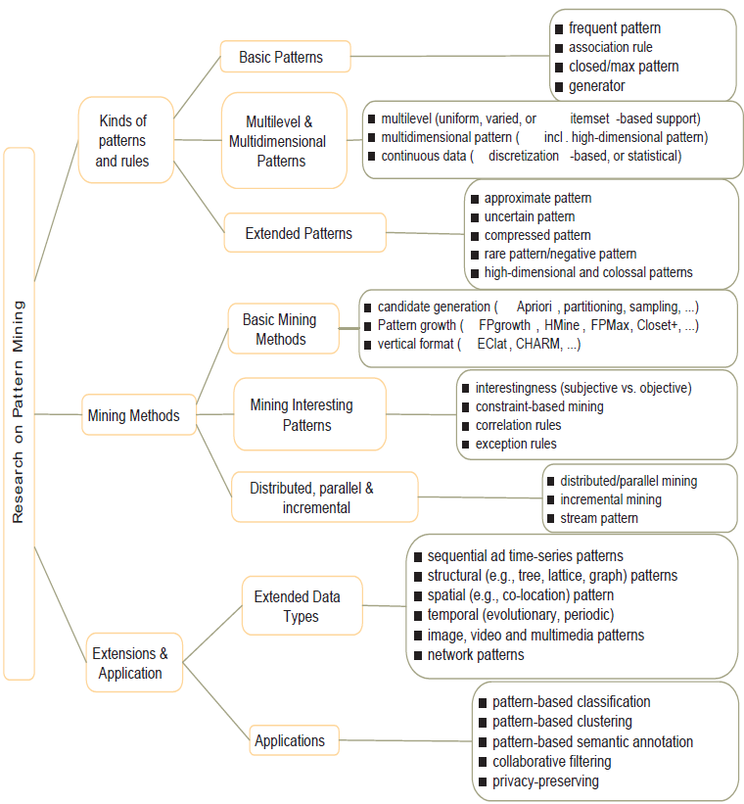
Research on Pattern Mining: A Road Map
‹#›

Slide 5
Chapter 7 : Advanced Frequent Pattern Mining
Pattern Mining: A Road Map
Pattern Mining in Multi-Level, Multi-Dimensional Space
Mining Multi-Level Association
Mining Multi-Dimensional Association
Mining Quantitative Association Rules
Mining Rare Patterns and Negative Patterns
Constraint-Based Frequent Pattern Mining
Mining High-Dimensional Data and Colossal Patterns
Mining Compressed or Approximate Patterns
Pattern Exploration and Application
Summary
‹#›
Notes:
‹#›

Slide 6
Mining Multiple-Level Association Rules
Items often form hierarchies
Flexible support settings
Items at the lower level are expected to have lower support
Exploration of shared multi-level mining (Agrawal & Srikant@VLB’95, Han & Fu@VLDB’95)
uniform support
reduced support
Level 1
min_sup = 5%
Milk
[support = 10%]
Level 1
min_sup = 5%
Level 2
min_sup = 5%
2% Milk
[support = 6%]
Skim Milk
[support = 4%]
Level 2
min_sup = 3%
‹#›
Notes:
‹#›

Slide 7
Multi-level Association: Flexible Support and Redundancy filtering
Flexible min-support thresholds: Some items are more valuable but less frequent
Use non-uniform, group-based min-support
E.g., {diamond, watch, camera}: 0.05%; {bread, milk}: 5%; …
Redundancy Filtering: Some rules may be redundant due to “ancestor” relationships between items
milk ⇒ wheat bread [support = 8%, confidence = 70%]
2% milk ⇒ wheat bread [support = 2%, confidence = 72%]
The first rule is an ancestor of the second rule
A rule is redundant if its support is close to the “expected” value, based on the rule’s ancestor
‹#›
Notes:
‹#›

Slide 8
Chapter 7 : Advanced Frequent Pattern Mining
Pattern Mining: A Road Map
Pattern Mining in Multi-Level, Multi-Dimensional Space
Mining Multi-Level Association
Mining Multi-Dimensional Association
Mining Quantitative Association Rules
Mining Rare Patterns and Negative Patterns
Constraint-Based Frequent Pattern Mining
Mining High-Dimensional Data and Colossal Patterns
Mining Compressed or Approximate Patterns
Pattern Exploration and Application
Summary
‹#›
Notes:
‹#›

Slide 9
Mining Multi-Dimensional Association
Single-dimensional rules:
buys(X, “milk”) ⇒ buys(X, “bread”)
Multi-dimensional rules: ≥ 2 dimensions or predicates
Inter-dimension assoc. rules (no repeated predicates)
age(X,”19-25”) ∧ occupation(X,“student”) ⇒ buys(X, “coke”)
hybrid-dimension assoc. rules (repeated predicates)
age(X,”19-25”) ∧ buys(X, “popcorn”) ⇒ buys(X, “coke”)
Categorical Attributes: finite number of possible values, no ordering among values—data cube approach
Quantitative Attributes: Numeric, implicit ordering among values—discretization, clustering, and gradient approaches
‹#›
Notes:
‹#›

Slide 10
Chapter 7 : Advanced Frequent Pattern Mining
Pattern Mining: A Road Map
Pattern Mining in Multi-Level, Multi-Dimensional Space
Mining Multi-Level Association
Mining Multi-Dimensional Association
Mining Quantitative Association Rules
Mining Rare Patterns and Negative Patterns
Constraint-Based Frequent Pattern Mining
Mining High-Dimensional Data and Colossal Patterns
Mining Compressed or Approximate Patterns
Pattern Exploration and Application
Summary
‹#›
Notes:
‹#›

Slide 11
Mining Quantitative Associations
Techniques can be categorized by how numerical attributes, such as age or salary are treated
Static discretization based on predefined concept hierarchies (data cube methods)
Dynamic discretization based on data distribution (quantitative rules, e.g., Agrawal & Srikant@SIGMOD96)
Clustering: Distance-based association (e.g., Yang & Miller@SIGMOD97)
One dimensional clustering then association
Deviation: (such as Aumann and Lindell@KDD99)
Sex = female => Wage: mean=$7/hr (overall mean = $9)
‹#›
Notes:
‹#›

Slide 12
Static Discretization of Quantitative Attributes
Discretized prior to mining using concept hierarchy.
Numeric values are replaced by ranges
In relational database, finding all frequent k-predicate sets will require k or k+1 table scans
Data cube is well suited for mining
The cells of an n-dimensional
cuboid correspond to the
predicate sets
Mining from data cubes can be much faster
()
(age)
(income)
(buys)
(age, income)
(age,buys)
(income,buys)
(age,income,buys)
‹#›
Notes:
‹#›

Slide 13
Quantitative Association Rules Based on Statistical Inference Theory [Aumann and Lindell@DMKD’03]
Finding extraordinary and therefore interesting phenomena, e.g.,
(Sex = female) => Wage: mean=$7/hr (overall mean = $9)
LHS: a subset of the population
RHS: an extraordinary behavior of this subset
The rule is accepted only if a statistical test (e.g., Z-test) confirms the inference with high confidence
Subrule: highlights the extraordinary behavior of a subset of the pop. of the super rule
E.g., (Sex = female) ^ (South = yes) => mean wage = $6.3/hr
Two forms of rules
Categorical => quantitative rules, or Quantitative => quantitative rules
E.g., Education in [14-18] (yrs) => mean wage = $11.64/hr
Open problem: Efficient methods for LHS containing two or more quantitative attributes
‹#›
Notes:
‹#›

Slide 14
Chapter 7 : Advanced Frequent Pattern Mining
Pattern Mining: A Road Map
Pattern Mining in Multi-Level, Multi-Dimensional Space
Mining Multi-Level Association
Mining Multi-Dimensional Association
Mining Quantitative Association Rules
Mining Rare Patterns and Negative Patterns
Constraint-Based Frequent Pattern Mining
Mining High-Dimensional Data and Colossal Patterns
Mining Compressed or Approximate Patterns
Pattern Exploration and Application
Summary
‹#›
Notes:
‹#›

Slide 15
Negative and Rare Patterns
Rare patterns: Very low support but interesting
E.g., buying Rolex watches
Mining: Setting individual-based or special group-based support threshold for valuable items
Negative patterns
Since it is unlikely that one buys Ford Expedition (an SUV car) and Toyota Prius (a hybrid car) together, Ford Expedition and Toyota Prius are likely negatively correlated patterns
Negatively correlated patterns that are infrequent tend to be more interesting than those that are frequent
‹#›
Notes:
‹#›

Slide 16
Defining Negative Correlated Patterns (I)
Definition 1 (support-based)
If itemsets X and Y are both frequent but rarely occur together, i.e.,
sup(X U Y) < sup (X) * sup(Y)
Then X and Y are negatively correlated
Problem: A store sold two needle 100 packages A and B, only one transaction containing both A and B.
When there are in total 200 transactions, we have
s(A U B) = 0.005, s(A) * s(B) = 0.25, s(A U B) < s(A) * s(B)
When there are 10⁵ transactions, we have
s(A U B) = 1/10⁵, s(A) * s(B) = 1/10^{3 *} 1/10³, s(A U B) > s(A) * s(B)
Where is the problem? —Null transactions, i.e., the support-based definition is not null-invariant!
‹#›
Notes:
‹#›

Slide 17
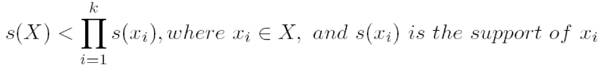
Defining Negative Correlated Patterns (II)
Definition 2 (negative itemset-based)
X is a negative itemset if (1) X = Ā U B, where B is a set of positive items, and Ā is a set of negative items, |Ā|≥ 1, and (2) s(X) ≥ μ
Itemsets X is negatively correlated, if
This definition suffers a similar null-invariant problem
Definition 3 (Kulzynski measure-based) If itemsets X and Y are frequent, but (P(X|Y) + P(Y|X))/2 < є, where є is a negative pattern threshold, then X and Y are negatively correlated.
Ex. For the same needle package problem, when no matter there are 200 or 10⁵ transactions, if є = 0.01, we have
(P(A|B) + P(B|A))/2 = (0.01 + 0.01)/2 < є
‹#›
Notes:
‹#›

Slide 18
Chapter 7 : Advanced Frequent Pattern Mining
Pattern Mining: A Road Map
Pattern Mining in Multi-Level, Multi-Dimensional Space
Constraint-Based Frequent Pattern Mining
Mining High-Dimensional Data and Colossal Patterns
Mining Compressed or Approximate Patterns
Pattern Exploration and Application
Summary
‹#›
Notes:
‹#›

Slide 19
Constraint-based (Query-Directed) Mining
Finding all the patterns in a database autonomously? — unrealistic!
The patterns could be too many but not focused!
Data mining should be an interactive process
User directs what to be mined using a data mining query language (or a graphical user interface)
Constraint-based mining
User flexibility: provides constraints on what to be mined
Optimization: explores such constraints for efficient mining — constraint-based mining: constraint-pushing, similar to push selection first in DB query processing
Note: still find all the answers satisfying constraints, not finding some answers in “heuristic search”
‹#›
Notes:
‹#›

Slide 20
Constraints in Data Mining
Knowledge type constraint:
classification, association, etc.
Data constraint — using SQL-like queries
find product pairs sold together in stores in Chicago this year
Dimension/level constraint
in relevance to region, price, brand, customer category
Rule (or pattern) constraint
small sales (price < $10) triggers big sales (sum > $200)
Interestingness constraint
strong rules: min_support ≥ 3%, min_confidence ≥ 60%
‹#›
Notes:
‹#›

Slide 21
Meta-Rule Guided Mining
Meta-rule can be in the rule form with partially instantiated predicates and constants
P₁(X, Y) ^ P₂(X, W) => buys(X, “iPad”)
The resulting rule derived can be
age(X, “15-25”) ^ profession(X, “student”) => buys(X, “iPad”)
In general, it can be in the form of
P₁ ^ P₂ ^ … ^ P_{l} => Q₁ ^ Q₂ ^ … ^ Q_{r}
Method to find meta-rules
Find frequent (l+r) predicates (based on min-support threshold)
Push constants deeply when possible into the mining process (see the remaining discussions on constraint-push techniques)
Use confidence, correlation, and other measures when possible
‹#›

Slide 22
Constraint-Based Frequent Pattern Mining
Pattern space pruning constraints
Anti-monotonic: If constraint c is violated, its further mining can be terminated
Monotonic: If c is satisfied, no need to check c again
Succinct: c must be satisfied, so one can start with the data sets satisfying c
Convertible: c is not monotonic nor anti-monotonic, but it can be converted into it if items in the transaction can be properly ordered
Data space pruning constraint
Data succinct: Data space can be pruned at the initial pattern mining process
Data anti-monotonic: If a transaction t does not satisfy c, t can be pruned from its further mining
‹#›
Notes:
‹#›

Slide 23
Pattern Space Pruning with Anti-Monotonicity Constraints
TDB (min_sup=2)
A constraint C is anti-monotone if the super pattern satisfies C, all of its sub-patterns do so too
In other words, anti-monotonicity: If an itemset S violates the constraint, so does any of its superset
Ex. 1. sum(S.price) ≤ v is anti-monotone
Ex. 2. range(S.profit) ≤ 15 is anti-monotone
Itemset ab violates C
So does every superset of ab
Ex. 3. sum(S.Price) ≥ v is not anti-monotone
Ex. 4. support count is anti-monotone: core property used in Apriori
TID | Transaction
10 | a, b, c, d, f
20 | b, c, d, f, g, h
30 | a, c, d, e, f
40 | c, e, f, g
Item | Profit
a | 40
b | 0
c | -20
d | 10
e | -30
f | 30
g | 20
h | -10
‹#›
Notes:
‹#›

Slide 24
Pattern Space Pruning with Monotonicity Constraints
TDB (min_sup=2)
A constraint C is monotone if the pattern satisfies C, we do not need to check C in subsequent mining
Alternatively, monotonicity: If an itemset S satisfies the constraint, so does any of its superset
Ex. 1. sum(S.Price) ≥ v is monotone
Ex. 2. min(S.Price) ≤ v is monotone
Ex. 3. C: range(S.profit) ≥ 15
Itemset ab satisfies C
So does every superset of ab
TID | Transaction
10 | a, b, c, d, f
20 | b, c, d, f, g, h
30 | a, c, d, e, f
40 | c, e, f, g
Item | Profit
a | 40
b | 0
c | -20
d | 10
e | -30
f | 30
g | 20
h | -10
‹#›
Notes:
‹#›

Slide 25
Data Space Pruning with Data Anti-monotonicity
TDB (min_sup=2)
A constraint c is data anti-monotone if for a pattern p cannot satisfy a transaction t under c, p’s superset cannot satisfy t under c either
The key for data anti-monotone is recursive data reduction
Ex. 1. sum(S.Price) ≥ v is data anti-monotone
Ex. 2. min(S.Price) ≤ v is data anti-monotone
Ex. 3. C: range(S.profit) ≥ 25 is data anti-monotone
Itemset {b, c}’s projected DB:
T10’: {d, f, h}, T20’: {d, f, g, h}, T30’: {d, f, g}
since C cannot satisfy T10’, T10’ can be pruned
TID | Transaction
10 | a, b, c, d, f, h
20 | b, c, d, f, g, h
30 | b, c, d, f, g
40 | c, e, f, g
Item | Profit
a | 40
b | 0
c | -20
d | -15
e | -30
f | -10
g | 20
h | -5
‹#›
Notes:
‹#›

Slide 26
Pattern Space Pruning with Succinctness
Succinctness:
Given A_{1,} the set of items satisfying a succinctness constraint C, then any set S satisfying C is based on A₁ , i.e., S contains a subset belonging to A₁
Idea: Without looking at the transaction database, whether an itemset S satisfies constraint C can be determined based on the selection of items
min(S.Price) ≤ v is succinct
sum(S.Price) ≥ v is not succinct
Optimization: If C is succinct, C is pre-counting pushable
‹#›
Notes:
‹#›

Slide 27
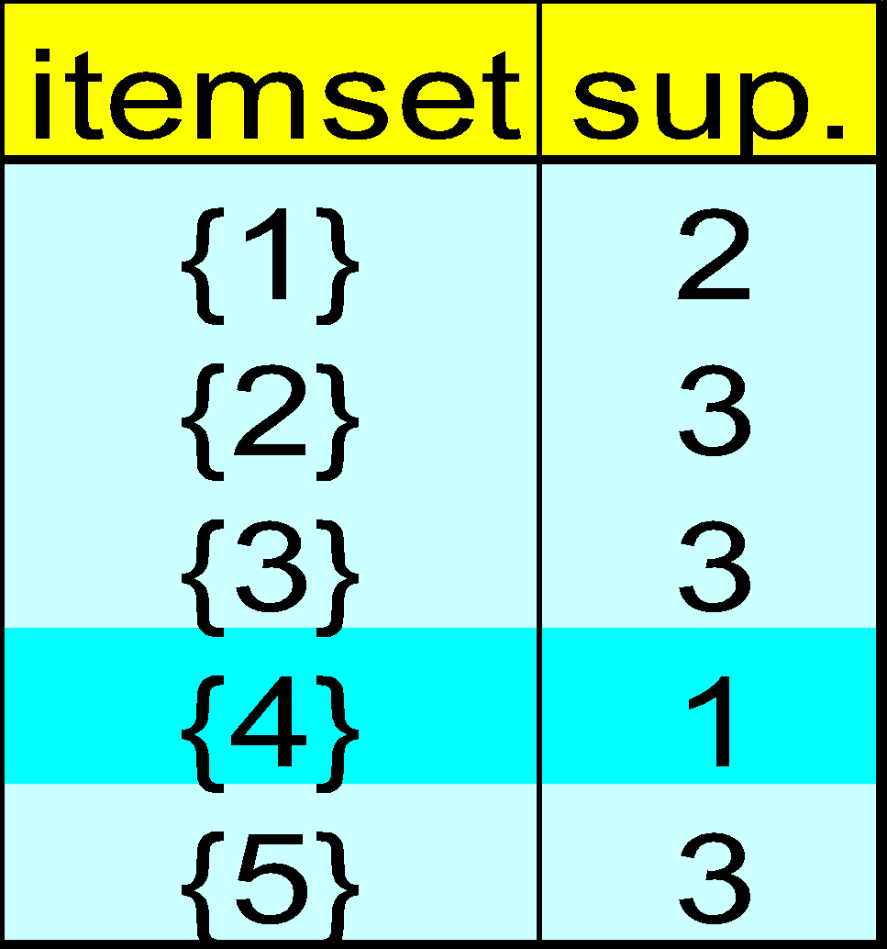
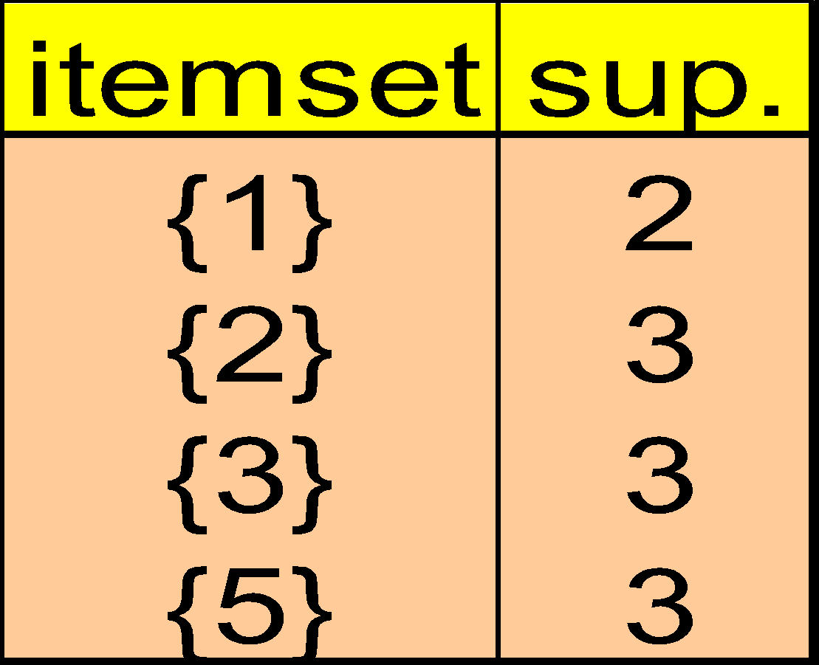
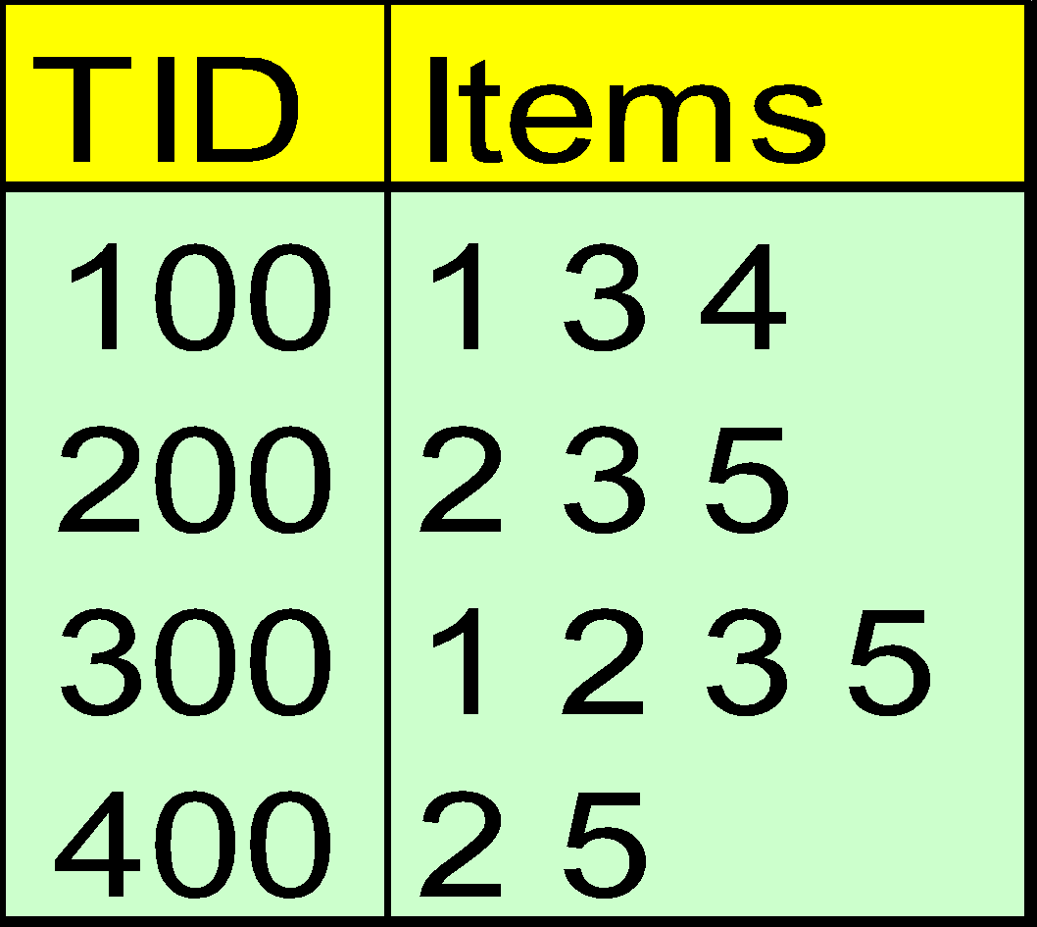
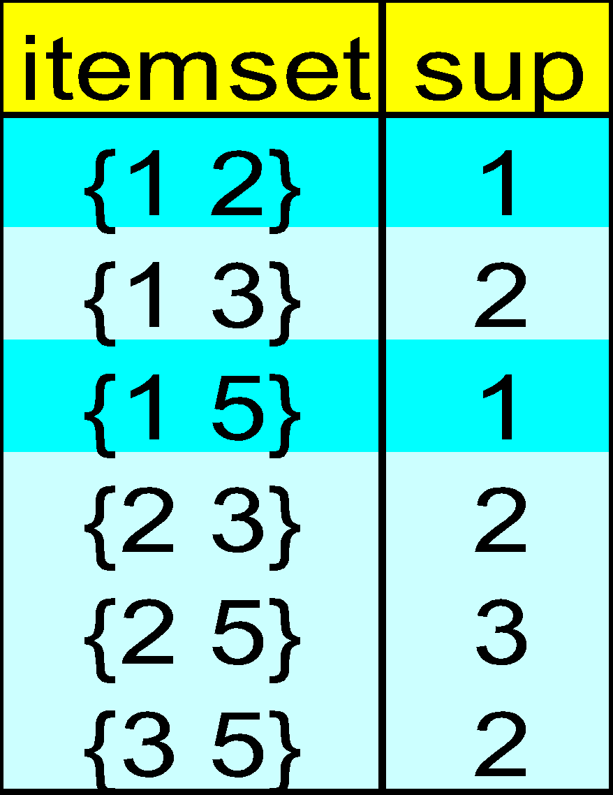
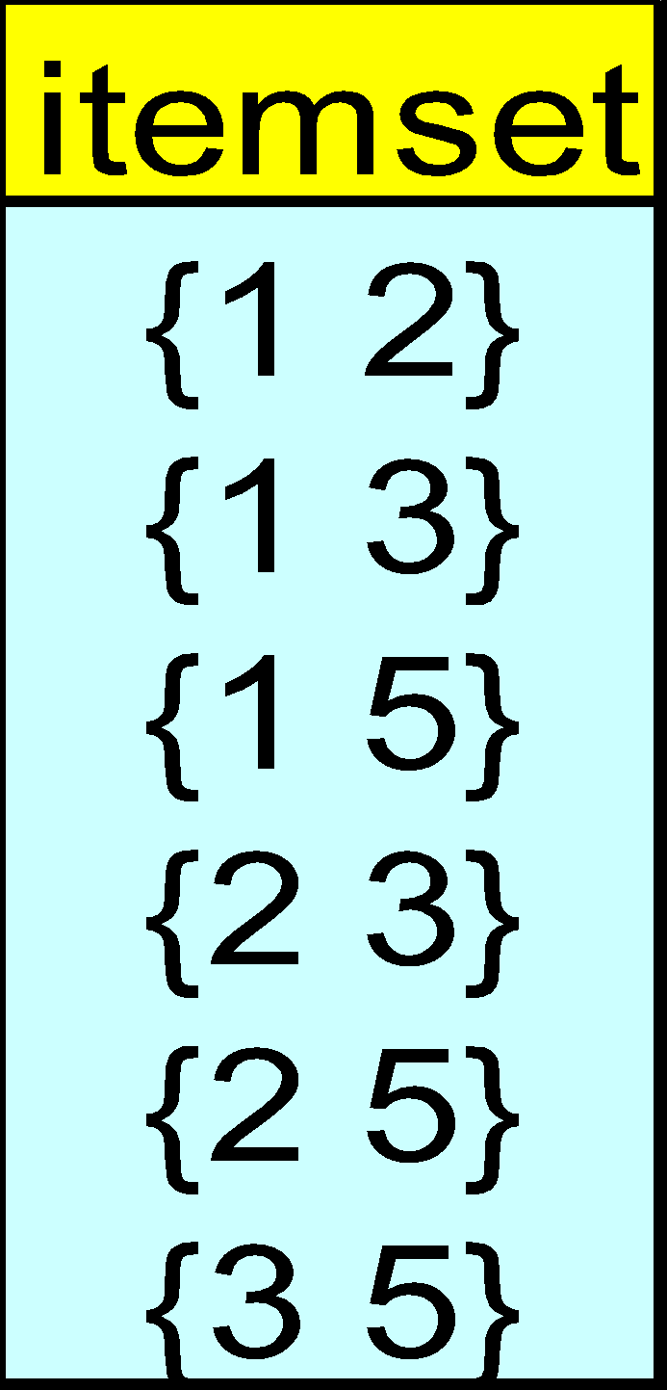
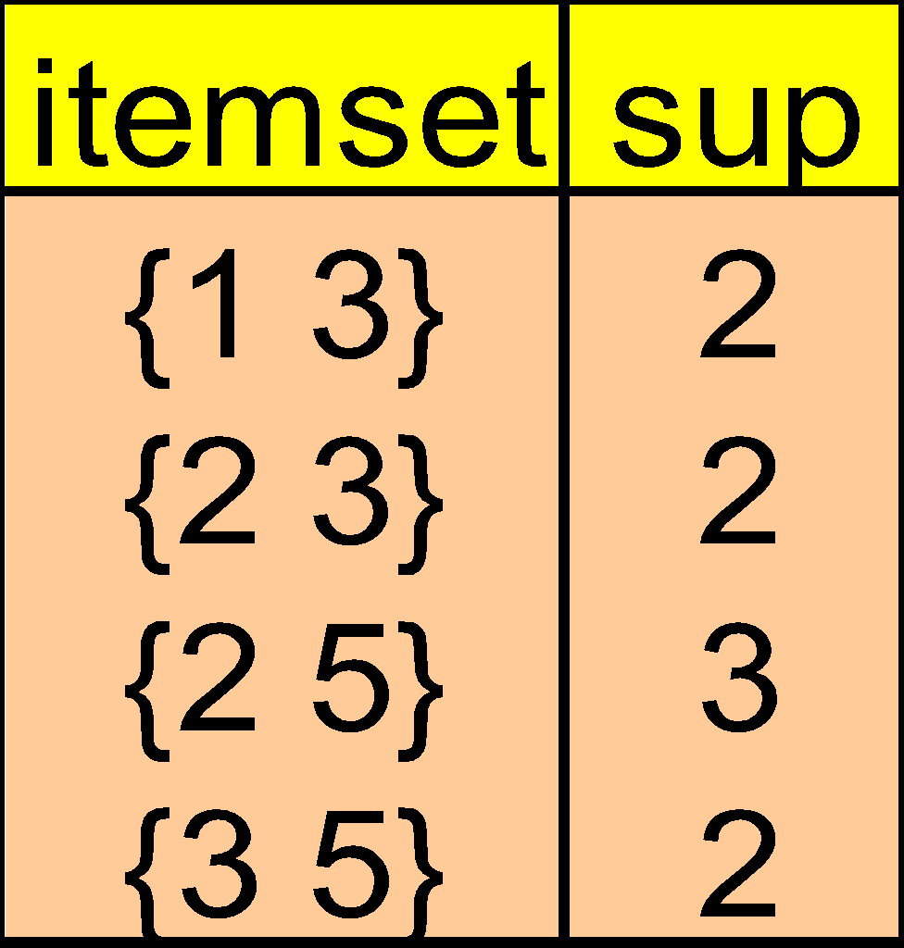
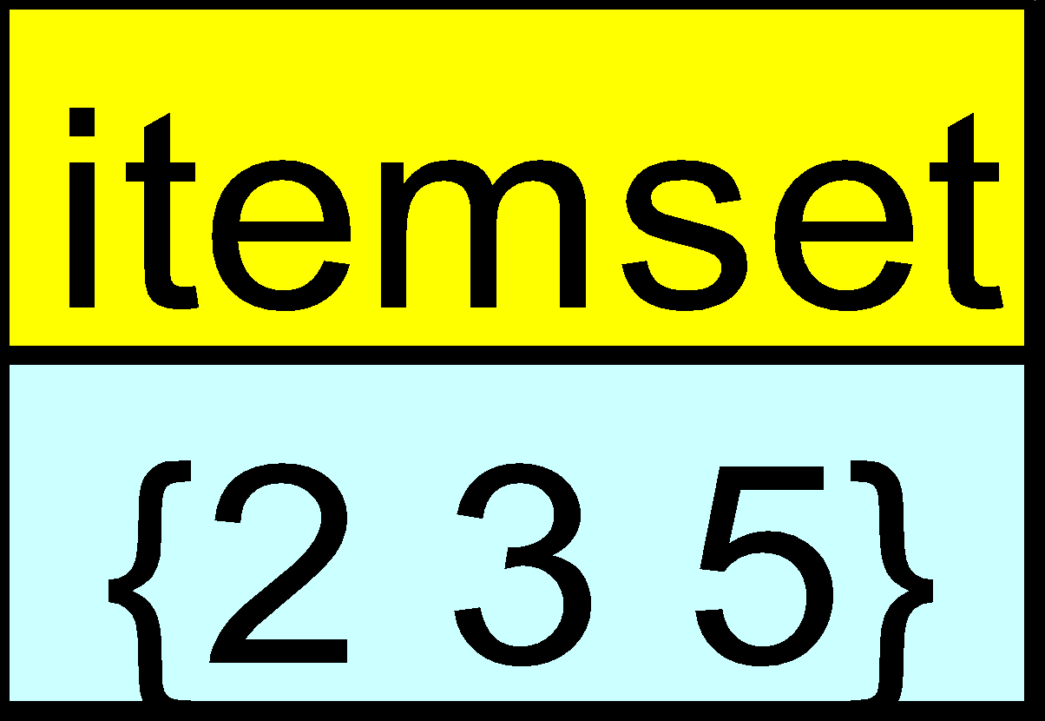
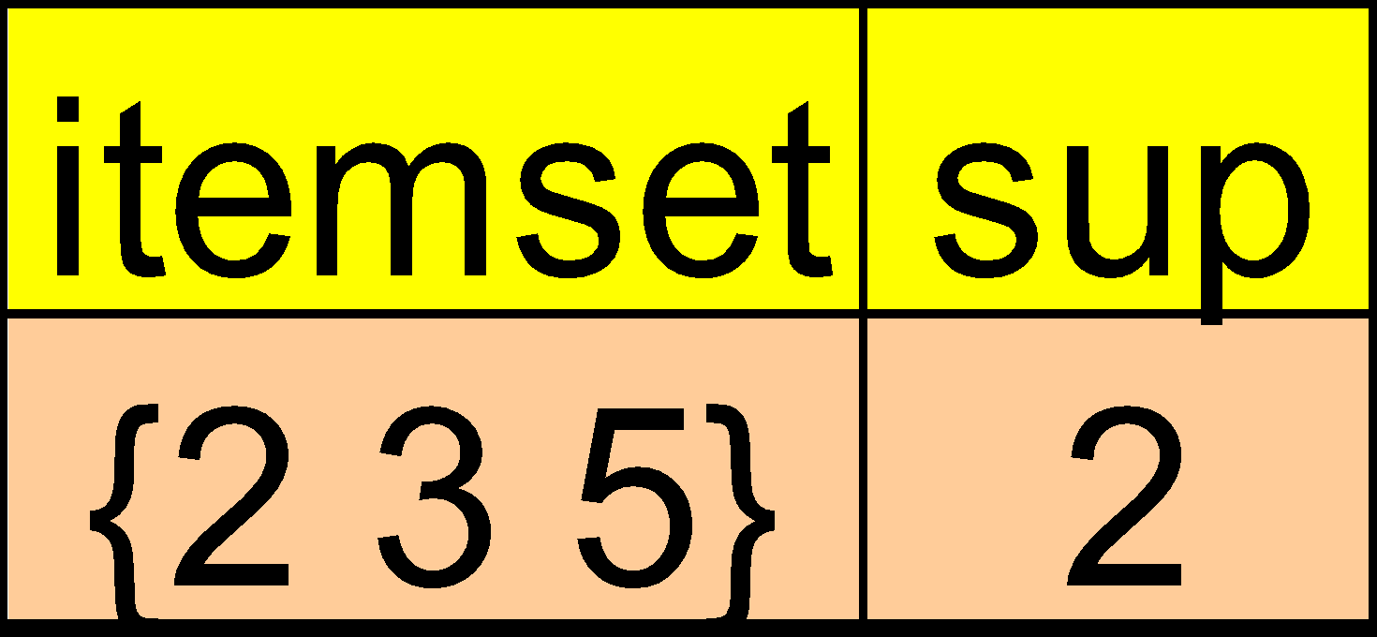
Naïve Algorithm: Apriori + Constraint
Database D
L₁
C₁
Scan D
C₂
C₂
L₂
Scan D
C₃
Scan D
L₃
Constraint:
Sum{S.price} < 5
‹#›
Notes:
‹#›

Slide 28
Constrained Apriori : Push a Succinct Constraint Deep
Database D
L₁
C₁
Scan D
C₂
C₂
L₂
Scan D
not immediately
to be used
C₃
Scan D
L₃
Constraint:
min{S.price } <= 1
‹#›
Notes:
‹#›

Slide 29
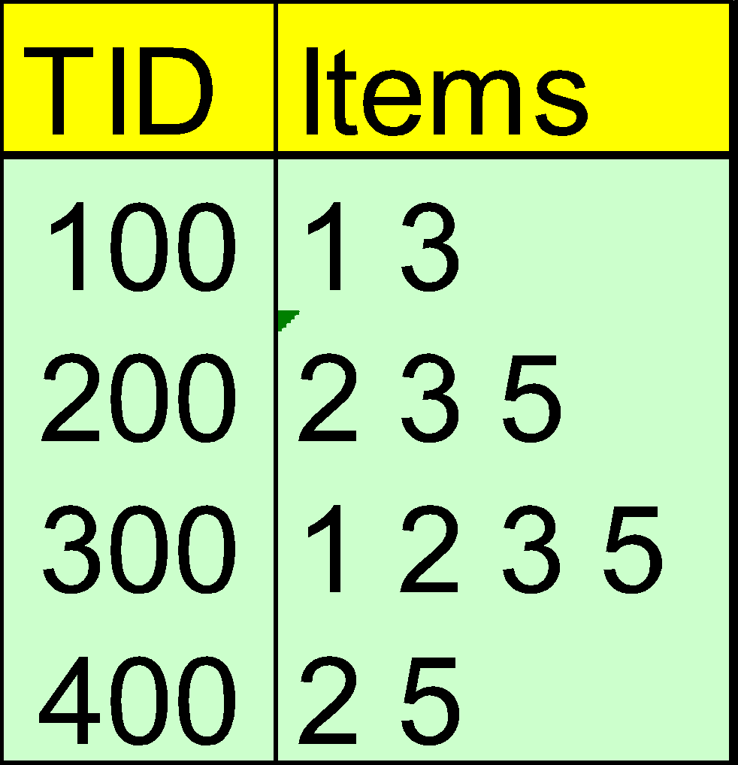
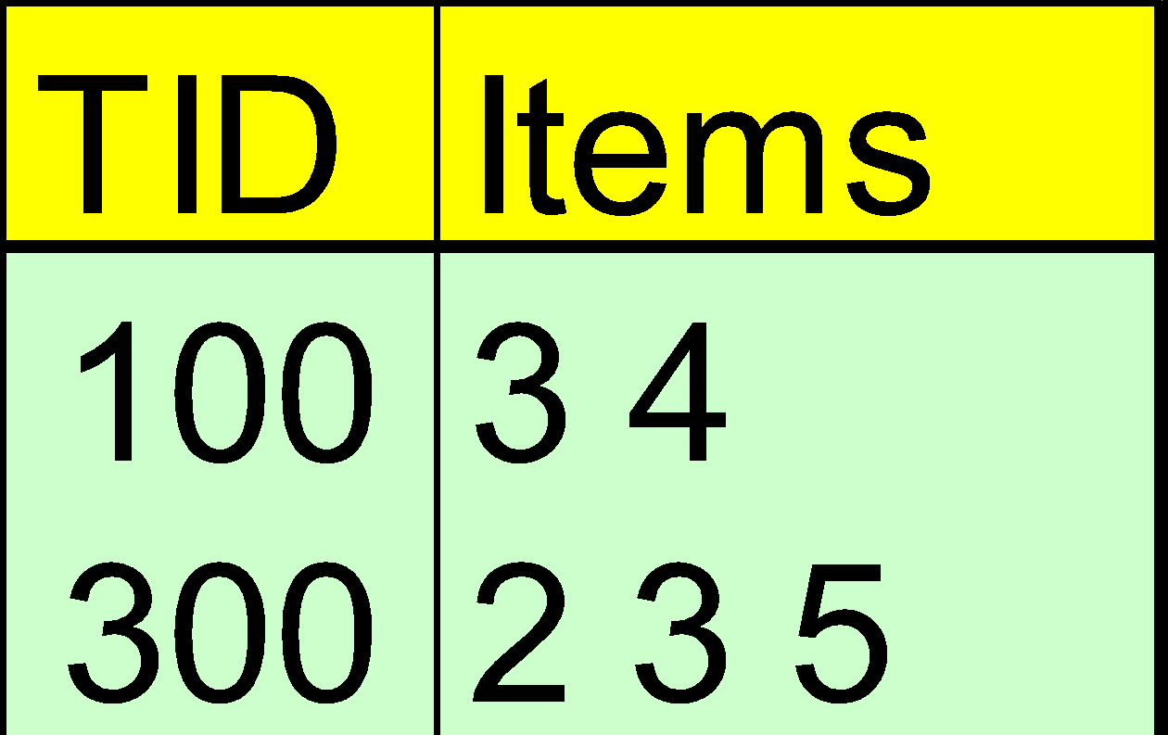
Constrained FP-Growth: Push a Succinct Constraint Deep
FP-Tree
Remove
infrequent
length 1
1-Projected DB
No Need to project on 2, 3, or 5
Constraint:
min{S.price } <= 1
‹#›
Notes:
‹#›

Slide 30
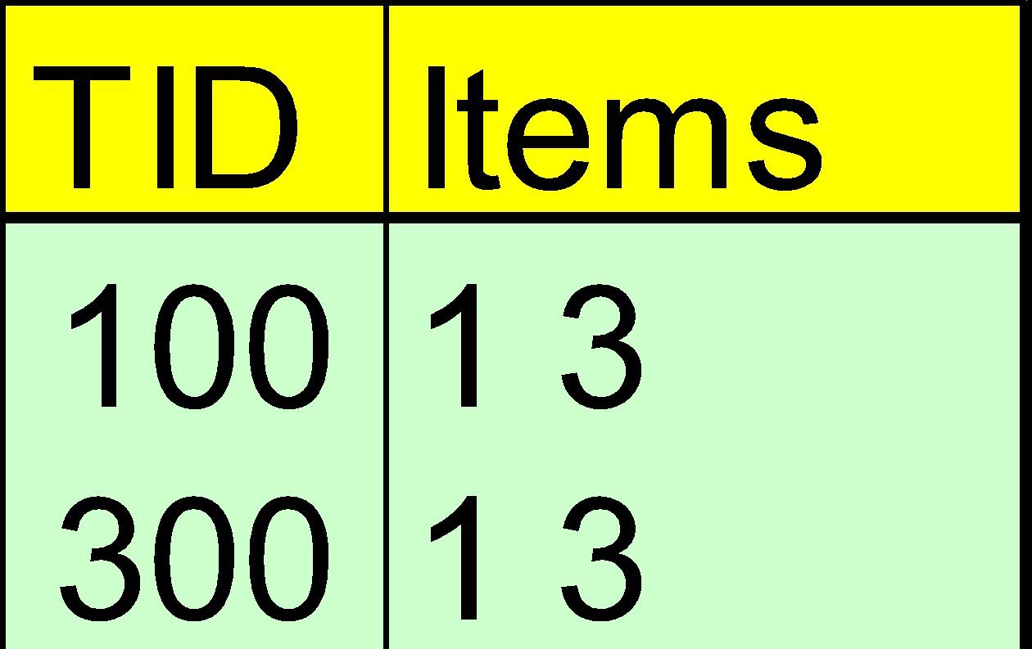
Constrained FP-Growth: Push a Data Anti-monotonic Constraint Deep
Remove from data
FP-Tree
Single branch, we are done
Constraint:
min{S.price } <= 1
‹#›
Notes:
‹#›

Slide 31
Constrained FP-Growth: Push a Data Anti-monotonic Constraint Deep
TID | Transaction
10 | a, b, c, d, f, h
20 | b, c, d, f, g, h
30 | b, c, d, f, g
40 | a, c, e, f, g
TID | Transaction
10 | a, b, c, d, f, h
20 | b, c, d, f, g, h
30 | b, c, d, f, g
40 | a, c, e, f, g
FP-Tree
Item | Profit
a | 40
b | 0
c | -20
d | -15
e | -30
f | -10
g | 20
h | -5
B-Projected DB
Recursive
Data
Pruning
TID | Transaction
10 | a, c, d, f, h
20 | c, d, f, g, h
30 | c, d, f, g
B
FP-Tree
Single branch:
bcdfg: 2
Constraint:
range{S.price } > 25
min_sup >= 2
‹#›
Notes:
‹#›

Slide 32
Convertible Constraints: Ordering Data in Transactions
TDB (min_sup=2)
Convert tough constraints into anti-monotone or monotone by properly ordering items
Examine C: avg(S.profit) ≥ 25
Order items in value-descending order
<a, f, g, d, b, h, c, e>
If an itemset afb violates C
So does afbh, afb*
It becomes anti-monotone!
TID | Transaction
10 | a, b, c, d, f
20 | b, c, d, f, g, h
30 | a, c, d, e, f
40 | c, e, f, g
Item | Profit
a | 40
b | 0
c | -20
d | 10
e | -30
f | 30
g | 20
h | -10
‹#›
Notes:
‹#›

Slide 33
Strongly Convertible Constraints
avg(X) ≥ 25 is convertible anti-monotone w.r.t. item value descending order R: <a, f, g, d, b, h, c, e>
If an itemset af violates a constraint C, so does every itemset with af as prefix, such as afd
avg(X) ≥ 25 is convertible monotone w.r.t. item value ascending order R⁻¹: <e, c, h, b, d, g, f, a>
If an itemset d satisfies a constraint C, so does itemsets df and dfa, which having d as a prefix
Thus, avg(X) ≥ 25 is strongly convertible
Item | Profit
a | 40
b | 0
c | -20
d | 10
e | -30
f | 30
g | 20
h | -10
‹#›
Notes:
‹#›

Slide 34
Can Apriori Handle Convertible Constraints?
A convertible, not monotone nor anti-monotone nor succinct constraint cannot be pushed deep into the an Apriori mining algorithm
Within the level wise framework, no direct pruning based on the constraint can be made
Itemset df violates constraint C: avg(X) >= 25
Since adf satisfies C, Apriori needs df to assemble adf, df cannot be pruned
But it can be pushed into frequent-pattern growth framework!
Item | Value
a | 40
b | 0
c | -20
d | 10
e | -30
f | 30
g | 20
h | -10
‹#›
Notes:
‹#›

Slide 35
Pattern Space Pruning w. Convertible Constraints
C: avg(X) >= 25, min_sup=2
List items in every transaction in value descending order R: <a, f, g, d, b, h, c, e>
C is convertible anti-monotone w.r.t. R
Scan TDB once
remove infrequent items
Item h is dropped
Itemsets a and f are good, …
Projection-based mining
Imposing an appropriate order on item projection
Many tough constraints can be converted into (anti)-monotone
Item | Value
a | 40
f | 30
g | 20
d | 10
b | 0
h | -10
c | -20
e | -30
TDB (min_sup=2)
TID | Transaction
10 | a, f, d, b, c
20 | f, g, d, b, c
30 | a, f, d, c, e
40 | f, g, h, c, e
‹#›
Notes:
‹#›

Slide 36
Handling Multiple Constraints
Different constraints may require different or even conflicting item-ordering
If there exists an order R s.t. both C₁ and C₂ are convertible w.r.t. R, then there is no conflict between the two convertible constraints
If there exists conflict on order of items
Try to satisfy one constraint first
Then using the order for the other constraint to mine frequent itemsets in the corresponding projected database
‹#›
Notes:
‹#›

Slide 37
What Constraints Are Convertible?
Constraint | Convertible anti-monotone | Convertible monotone | Strongly convertible
avg(S) ≤ , ≥ v | Yes | Yes | Yes
median(S) ≤ , ≥ v | Yes | Yes | Yes
sum(S) ≤ v (items could be of any value, v ≥ 0) | Yes | No | No
sum(S) ≤ v (items could be of any value, v ≤ 0) | No | Yes | No
sum(S) ≥ v (items could be of any value, v ≥ 0) | No | Yes | No
sum(S) ≥ v (items could be of any value, v ≤ 0) | Yes | No | No
……
‹#›
Notes:
‹#›

Slide 38
Constraint-Based Mining — A General Picture
Constraint | Anti-monotone | Monotone | Succinct
v ∈ S | no | yes | yes
S ⊇ V | no | yes | yes
S ⊆ V | yes | no | yes
min(S) ≤ v | no | yes | yes
min(S) ≥ v | yes | no | yes
max(S) ≤ v | yes | no | yes
max(S) ≥ v | no | yes | yes
count(S) ≤ v | yes | no | weakly
count(S) ≥ v | no | yes | weakly
sum(S) ≤ v ( a ∈ S, a ≥ 0 ) | yes | no | no
sum(S) ≥ v ( a ∈ S, a ≥ 0 ) | no | yes | no
range(S) ≤ v | yes | no | no
range(S) ≥ v | no | yes | no
avg(S) θ v, θ ∈ { =, ≤, ≥ } | convertible | convertible | no
support(S) ≥ ξ | yes | no | no
support(S) ≤ ξ | no | yes | no
‹#›
Notes:
‹#›

Slide 39
Chapter 7 : Advanced Frequent Pattern Mining
Pattern Mining: A Road Map
Pattern Mining in Multi-Level, Multi-Dimensional Space
Constraint-Based Frequent Pattern Mining
Mining High-Dimensional Data and Colossal Patterns
Mining Compressed or Approximate Patterns
Pattern Exploration and Application
Summary
‹#›
Notes:
‹#›

Slide 40
Mining Colossal Frequent Patterns
F. Zhu, X. Yan, J. Han, P. S. Yu, and H. Cheng, “Mining Colossal Frequent Patterns by Core Pattern Fusion”, ICDE'07.
We have many algorithms, but can we mine large (i.e., colossal) patterns? ― such as just size around 50 to 100? Unfortunately, not!
Why not? ― the curse of “downward closure” of frequent patterns
The “downward closure” property
Any sub-pattern of a frequent pattern is frequent.
Example. If (a₁, a₂, …, a₁₀₀) is frequent, then a₁, a₂, …, a₁₀₀, (a₁, a₂), (a₁, a₃), …, (a₁, a₁₀₀), (a₁, a₂, a₃), … are all frequent! There are about 2¹⁰⁰ such frequent itemsets!
No matter using breadth-first search (e.g., Apriori) or depth-first search (FPgrowth), we have to examine so many patterns
Thus the downward closure property leads to explosion!
‹#›
Notes:
‹#›

Slide 41
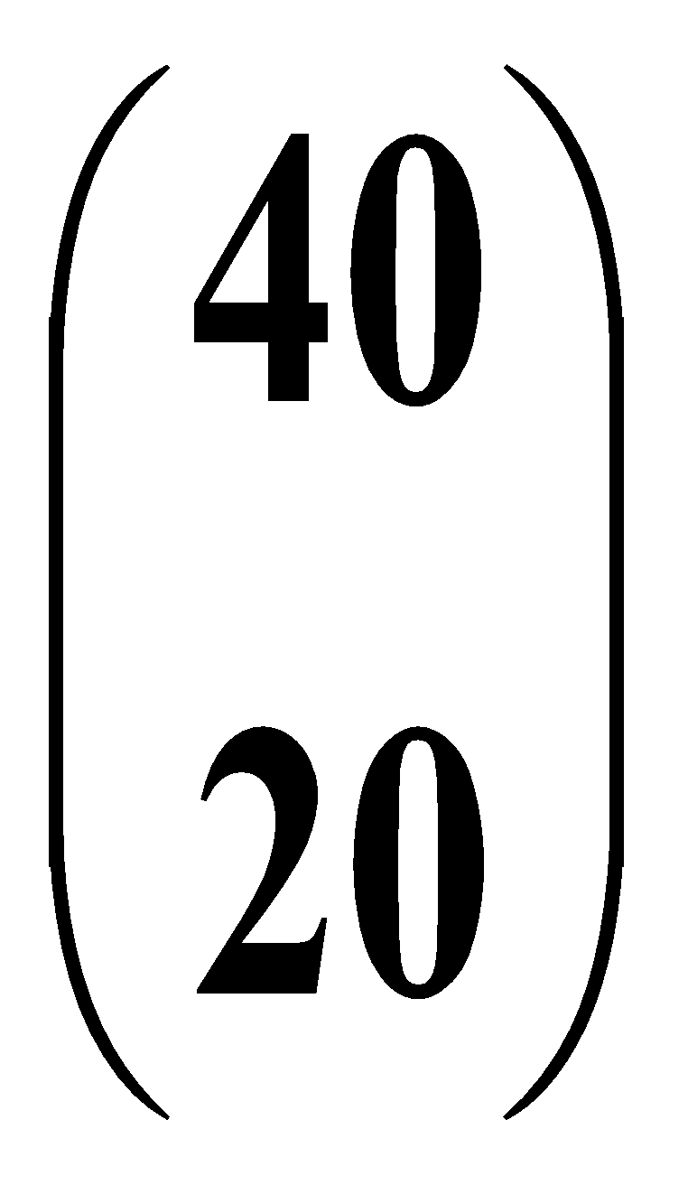
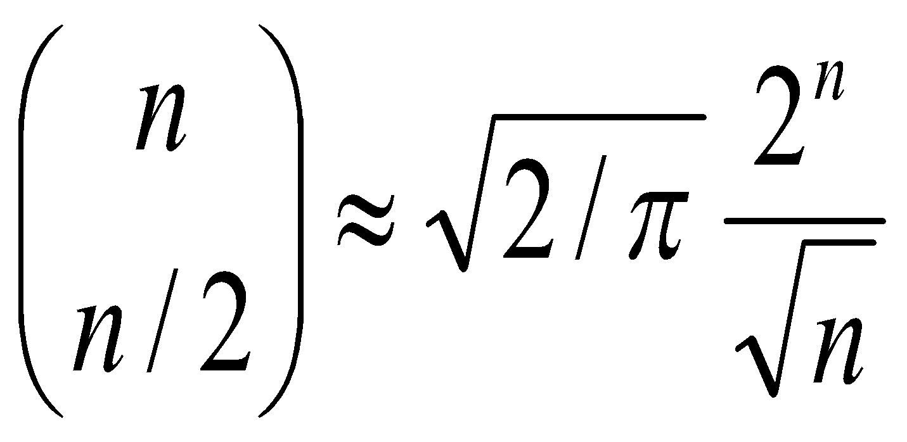
Colossal Patterns: A Motivating Example
Let’s make a set of 40 transactions
Closed/maximal patterns may partially alleviate the problem but not really solve it: We often need to mine scattered large patterns!
Let the minimum support threshold σ= 20
There are frequent patterns of size 20
Each is closed and maximal
# patterns =
The size of the answer set is exponential to n
T1 = 1 2 3 4 ….. 39 40
T2 = 1 2 3 4 ….. 39 40
: .
: .
: .
: .
T40=1 2 3 4 ….. 39 40
Then delete the items on the diagonal
T1 = 2 3 4 ….. 39 40
T2 = 1 3 4 ….. 39 40
: .
: .
: .
: .
T40=1 2 3 4 …… 39
‹#›
Notes:
‹#›

Slide 42
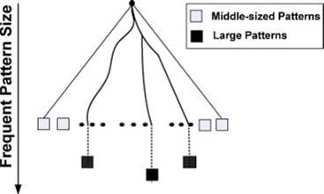
Colossal Pattern Set: Small but Interesting
It is often the case that only a small number of patterns are colossal, i.e., of large size
Colossal patterns are usually attached with greater importance than those of small pattern sizes
‹#›
Notes:
‹#›

Slide 43
Mining Colossal Patterns: Motivation and Philosophy
Motivation: Many real-world tasks need mining colossal patterns
Micro-array analysis in bioinformatics (when support is low)
Biological sequence patterns
Biological/sociological/information graph pattern mining
No hope for completeness
If the mining of mid-sized patterns is explosive in size, there is no hope to find colossal patterns efficiently by insisting “complete set” mining philosophy
Jumping out of the swamp of the mid-sized results
What we may develop is a philosophy that may jump out of the swamp of mid-sized results that are explosive in size and jump to reach colossal patterns
Striving for mining almost complete colossal patterns
The key is to develop a mechanism that may quickly reach colossal patterns and discover most of them
‹#›
Notes:
‹#›

Slide 44
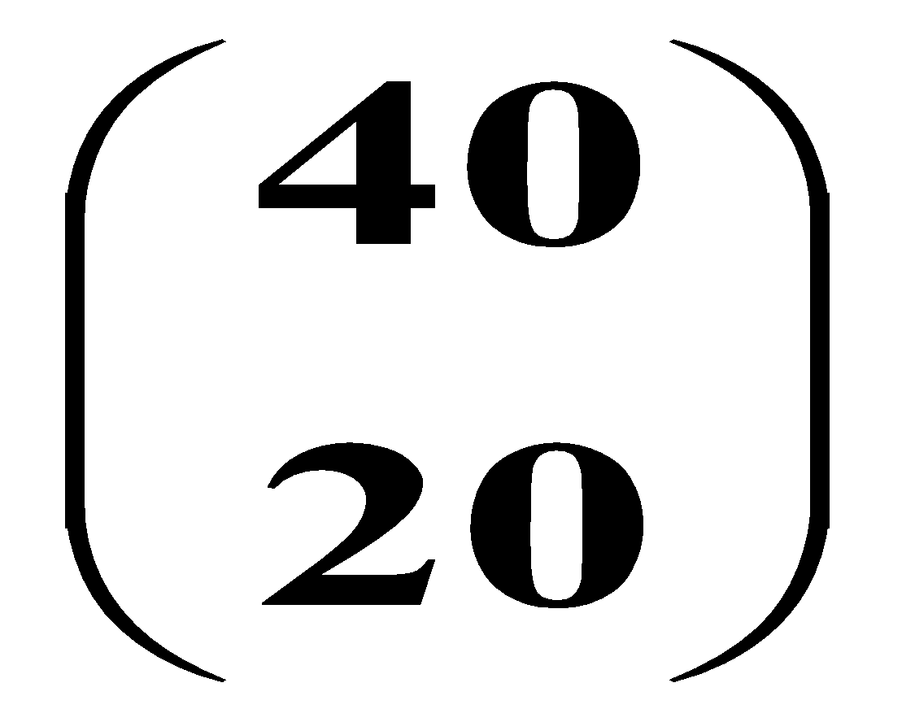
Alas, A Show of Colossal Pattern Mining!
Let the min-support threshold σ= 20
Then there are closed/maximal frequent patterns of size 20
However, there is only one with size greater than 20, (i.e., colossal):
α= {41,42,…,79} of size 39
T1 = 2 3 4 ….. 39 40
T2 = 1 3 4 ….. 39 40
: .
: .
: .
: .
T40=1 2 3 4 …… 39
T41= 41 42 43 ….. 79
T42= 41 42 43 ….. 79
: .
: .
T60= 41 42 43 … 79
The existing fastest mining algorithms (e.g., FPClose, LCM) fail to complete running
Our algorithm outputs this colossal pattern in seconds
‹#›
Notes:
‹#›

Slide 45
Methodology of Pattern-Fusion Strategy
Pattern-Fusion traverses the tree in a bounded-breadth way
Always pushes down a frontier of a bounded-size candidate pool
Only a fixed number of patterns in the current candidate pool will be used as the starting nodes to go down in the pattern tree ― thus avoids the exponential search space
Pattern-Fusion identifies “shortcuts” whenever possible
Pattern growth is not performed by single-item addition but by leaps and bounded: agglomeration of multiple patterns in the pool
These shortcuts will direct the search down the tree much more rapidly towards the colossal patterns
‹#›
Notes:
‹#›

Slide 46
Observation: Colossal Patterns and Core Patterns
Transaction Database D
A colossal pattern α
α
D
α1
Dα_{k}
α2
Dα1
Dα2
Dα
αk
Subpatterns α₁ to α_{k} cluster tightly around the colossal pattern α by sharing a similar support. We call such subpatterns core patterns of α
‹#›
Notes:
‹#›

Slide 47
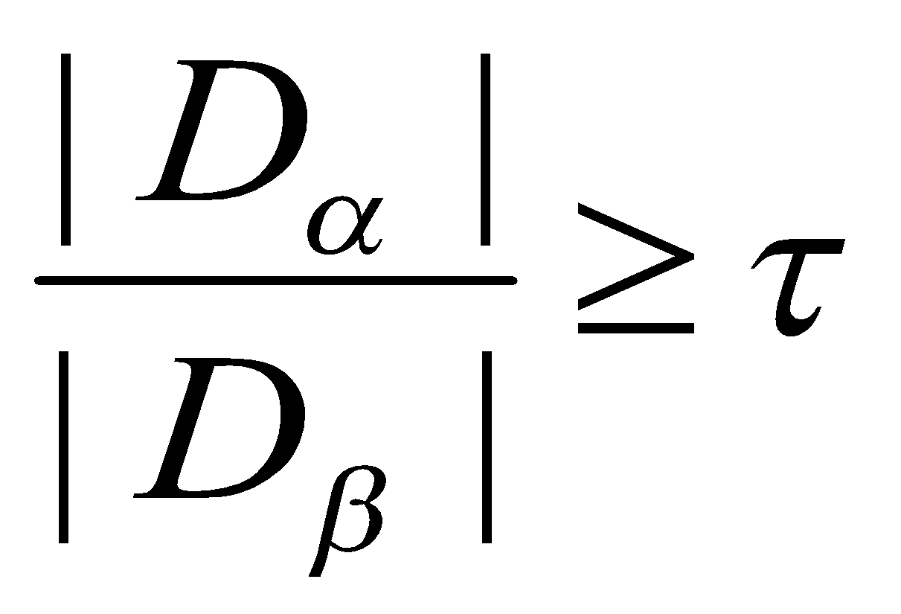
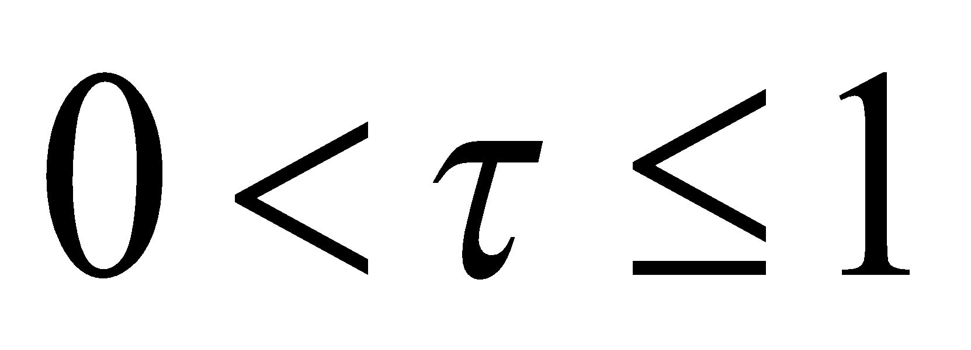
Robustness of Colossal Patterns
Core Patterns
Intuitively, for a frequent pattern α, a subpattern β is a τ-core pattern of α if β shares a similar support set with α, i.e.,
where τ is called the core ratio
Robustness of Colossal Patterns
A colossal pattern is robust in the sense that it tends to have much more core patterns than small patterns
‹#›
Notes:
‹#›

Slide 48
Example: Core Patterns
A colossal pattern has far more core patterns than a small-sized pattern
A colossal pattern has far more core descendants of a smaller size c
A random draw from a complete set of pattern of size c would more likely to pick a core descendant of a colossal pattern
A colossal pattern can be generated by merging a set of core patterns
Transaction (# of Ts) | Core Patterns (τ = 0.5)
(abe) (100) | (abe), (ab), (be), (ae), (e)
(bcf) (100) | (bcf), (bc), (bf)
(acf) (100) | (acf), (ac), (af)
(abcef) (100) | (ab), (ac), (af), (ae), (bc), (bf), (be) (ce), (fe), (e), (abc), (abf), (abe), (ace), (acf), (afe), (bcf), (bce), (bfe), (cfe), (abcf), (abce), (bcfe), (acfe), (abfe), (abcef)
‹#›
Notes:
‹#›

Slide 49
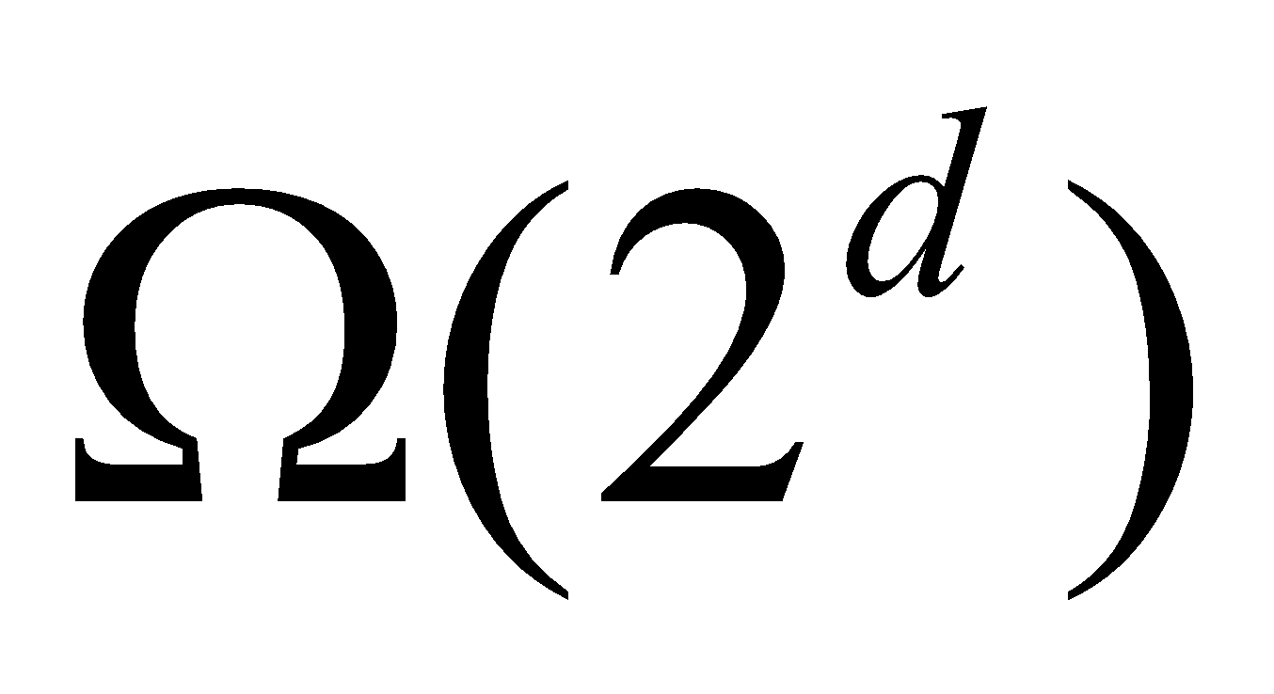
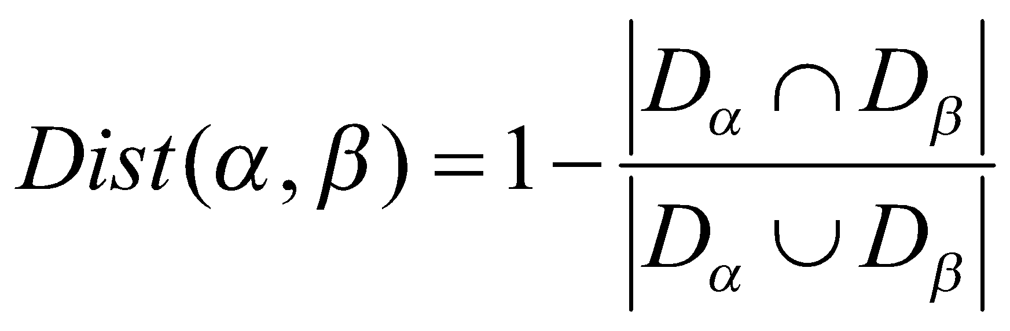
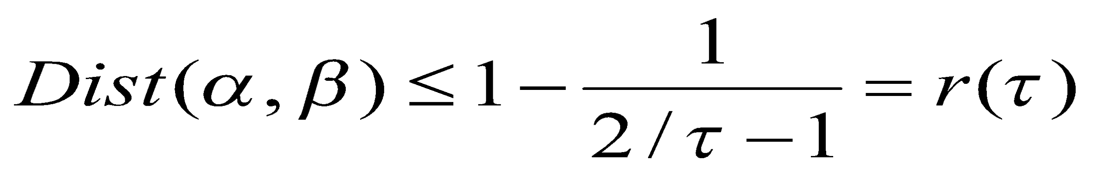
Robustness of Colossal Patterns
(d,τ)-robustness: A pattern α is (d, τ)-robust if d is the maximum number of items that can be removed from α for the resulting pattern to remain a τ-core pattern of α
For a (d,τ)-robust pattern α, it has core patterns
A colossal patterns tend to have a large number of core patterns
Pattern distance: For patterns α and β, the pattern distance of α and β is defined to be
If two patterns α and β are both core patterns of a same pattern, they would be bounded by a “ball” of a radius specified by their core ratio τ
Once we identify one core pattern, we will be able to find all the other core patterns by a bounding ball of radius r(τ)
‹#›
Notes:
‹#›

Slide 50
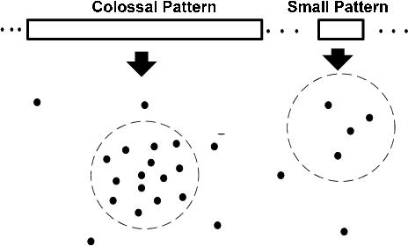
Colossal Patterns Correspond to Dense Balls
Due to their robustness, colossal patterns correspond to dense balls
Ω( 2^d) in population
A random draw in the pattern space will hit somewhere in the ball with high probability
‹#›
Notes:
‹#›

Slide 51
Idea of Pattern-Fusion Algorithm
Generate a complete set of frequent patterns up to a small size
Randomly pick a pattern β, and β has a high probability to be a core-descendant of some colossal pattern α
Identify all α’s descendants in this complete set, and merge all of them ― This would generate a much larger core-descendant of α
In the same fashion, we select K patterns. This set of larger core-descendants will be the candidate pool for the next iteration
‹#›
Notes:
‹#›

Slide 52
Pattern-Fusion: The Algorithm
Initialization (Initial pool): Use an existing algorithm to mine all frequent patterns up to a small size, e.g., 3
Iteration (Iterative Pattern Fusion):
At each iteration, k seed patterns are randomly picked from the current pattern pool
For each seed pattern thus picked, we find all the patterns within a bounding ball centered at the seed pattern
All these patterns found are fused together to generate a set of super-patterns. All the super-patterns thus generated form a new pool for the next iteration
Termination: when the current pool contains no more than K patterns at the beginning of an iteration
‹#›
Notes:
‹#›

Slide 53
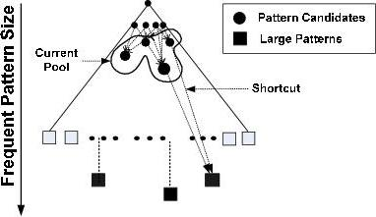
Why Is Pattern-Fusion Efficient?
A bounded-breadth pattern tree traversal
It avoids explosion in mining mid-sized ones
Randomness comes to help to stay on the right path
Ability to identify “short-cuts” and take “leaps”
fuse small patterns together in one step to generate new patterns of significant sizes
Efficiency
‹#›
Notes:
‹#›

Slide 54
Pattern-Fusion Leads to Good Approximation
Gearing toward colossal patterns
The larger the pattern, the greater the chance it will be generated
Catching outliers
The more distinct the pattern, the greater the chance it will be generated
‹#›
Notes:
‹#›

Slide 55
Experimental Setting
Synthetic data set
Diag_{n} an n x (n-1) table where i^{th} row has integers from 1 to n except i. Each row is taken as an itemset. min_support is n/2.
Real data set
Replace: A program trace data set collected from the “replace” program, widely used in software engineering research
ALL: A popular gene expression data set, a clinical data on ALL-AML leukemia (www.broad.mit.edu/tools/data.html).
Each item is a column, representing the activitiy level of gene/protein in the same
Frequent pattern would reveal important correlation between gene expression patterns and disease outcomes
‹#›
Notes:
‹#›

Slide 56
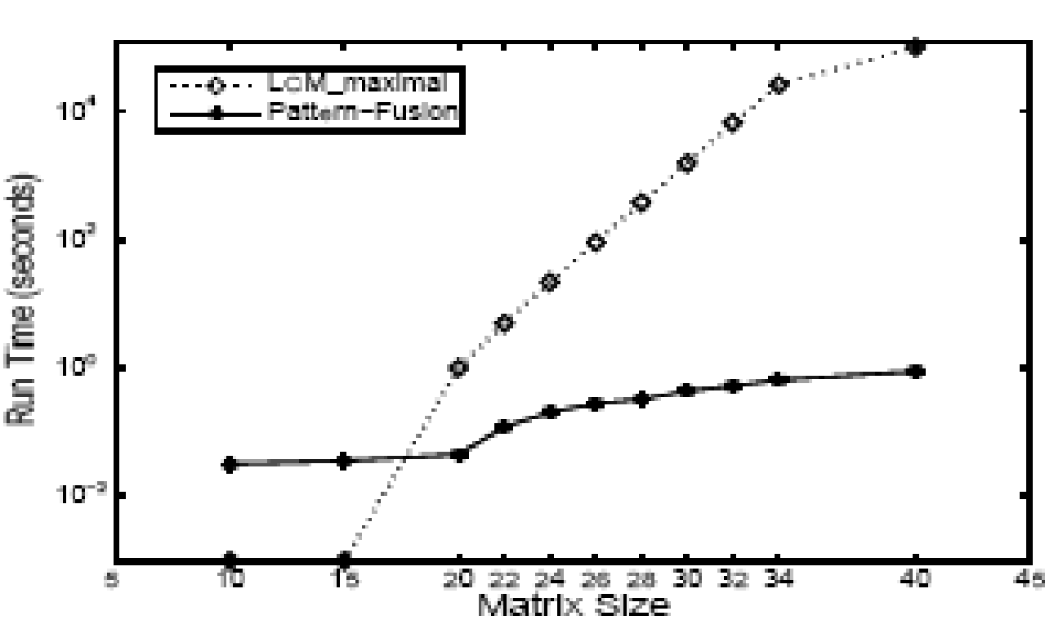
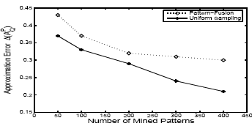
Experiment Results on Diag_{n}
LCM run time increases exponentially with pattern size n
Pattern-Fusion finishes efficiently
The approximation error of Pattern-Fusion (with min-sup 20) in comparison with the complete set) is rather close to uniform sampling (which randomly picks K patterns from the complete answer set)
‹#›
Notes:
‹#›

Slide 57
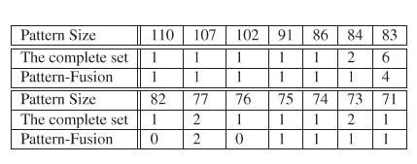
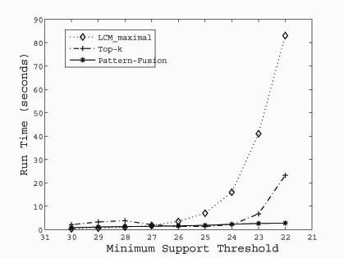
Experimental Results on ALL
ALL: A popular gene expression data set with 38 transactions, each with 866 columns
There are 1736 items in total
The table shows a high frequency threshold of 30
‹#›
Notes:
‹#›

Slide 58
Experimental Results on REPLACE
REPLACE
A program trace data set, recording 4395 calls and transitions
The data set contains 4395 transactions with 57 items in total
With support threshold of 0.03, the largest patterns are of size 44
They are all discovered by Pattern-Fusion with different settings of K and τ, when started with an initial pool of 20948 patterns of size <=3
‹#›
Notes:
‹#›

Slide 59
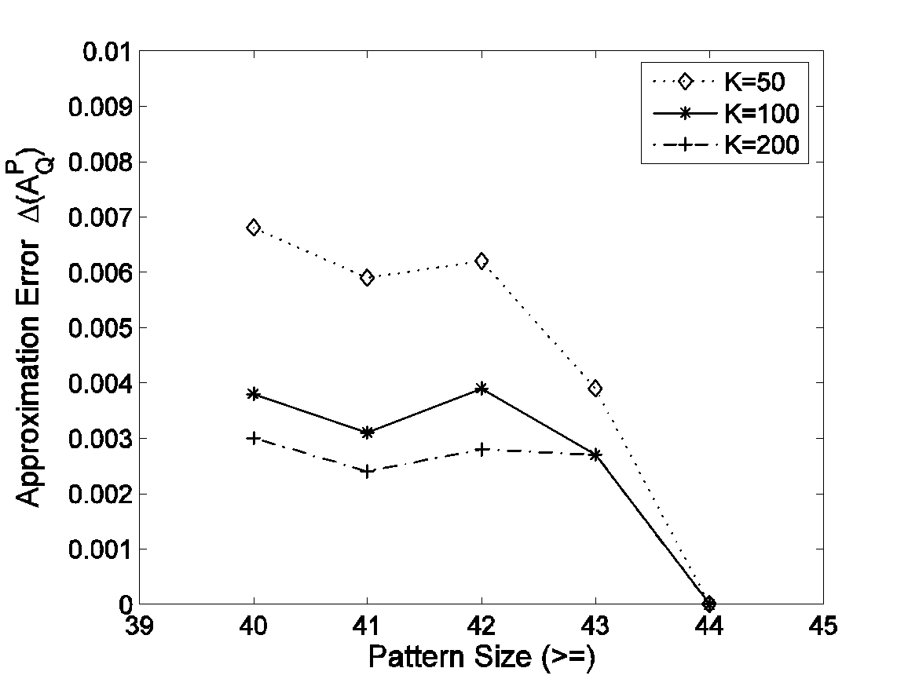
Experimental Results on REPLACE
Approximation error when compared with the complete mining result
Example. Out of the total 98 patterns of size >=42, when K=100, Pattern-Fusion returns 80 of them
A good approximation to the colossal patterns in the sense that any pattern in the complete set is on average at most 0.17 items away from one of these 80 patterns
‹#›
Notes:
‹#›

Slide 60
Chapter 7 : Advanced Frequent Pattern Mining
Pattern Mining: A Road Map
Pattern Mining in Multi-Level, Multi-Dimensional Space
Constraint-Based Frequent Pattern Mining
Mining High-Dimensional Data and Colossal Patterns
Mining Compressed or Approximate Patterns
Pattern Exploration and Application
Summary
‹#›
Notes:
‹#›

Slide 61
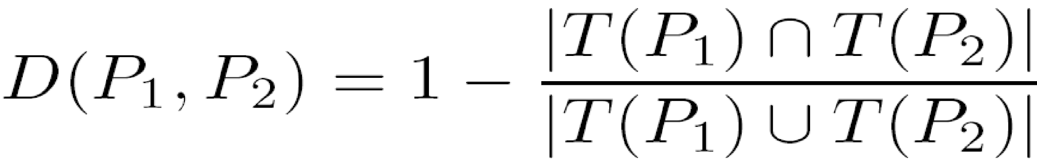
Mining Compressed Patterns: δ-clustering
Why compressed patterns?
too many, but less meaningful
Pattern distance measure
δ-clustering: For each pattern P, find all patterns which can be expressed by P and their distance to P are within δ (δ-cover)
All patterns in the cluster can be represented by P
Xin et al., “Mining Compressed Frequent-Pattern Sets”, VLDB’05
ID | Item-Sets | Support
P1 | {38,16,18,12} | 205227
P2 | {38,16,18,12,17} | 205211
P3 | {39,38,16,18,12,17} | 101758
P4 | {39,16,18,12,17} | 161563
P5 | {39,16,18,12} | 161576
Closed frequent pattern
Report P1, P2, P3, P4, P5
Emphasize too much on support
no compression
Max-pattern, P3: info loss
A desirable output: P2, P3, P4
‹#›
Notes:
‹#›

Slide 62
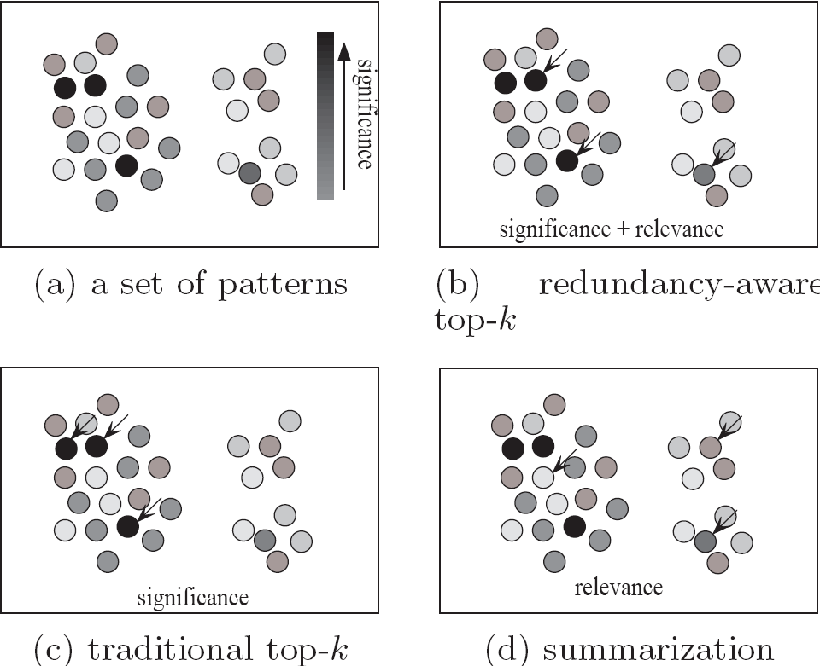
Redundancy-Award Top-k Patterns
Why redundancy-aware top-k patterns?
Desired patterns: high significance & low redundancy
Propose the MMS (Maximal Marginal Significance) for measuring the combined significance of a pattern set
Xin et al., Extracting Redundancy-Aware Top-K Patterns, KDD’06
‹#›
Notes:
‹#›

Slide 63
Chapter 7 : Advanced Frequent Pattern Mining
Pattern Mining: A Road Map
Pattern Mining in Multi-Level, Multi-Dimensional Space
Constraint-Based Frequent Pattern Mining
Mining High-Dimensional Data and Colossal Patterns
Mining Compressed or Approximate Patterns
Pattern Exploration and Application
Summary
‹#›
Notes:
‹#›

Slide 64
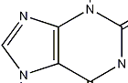
How to Understand and Interpret Patterns?
Do they all make sense?
What do they mean?
How are they useful?
diaper
beer
female sterile (2) tekele
morphological info. and simple statistics
Semantic Information
Not all frequent patterns are useful, only meaningful ones …
Annotate patterns with semantic information

Slide 65
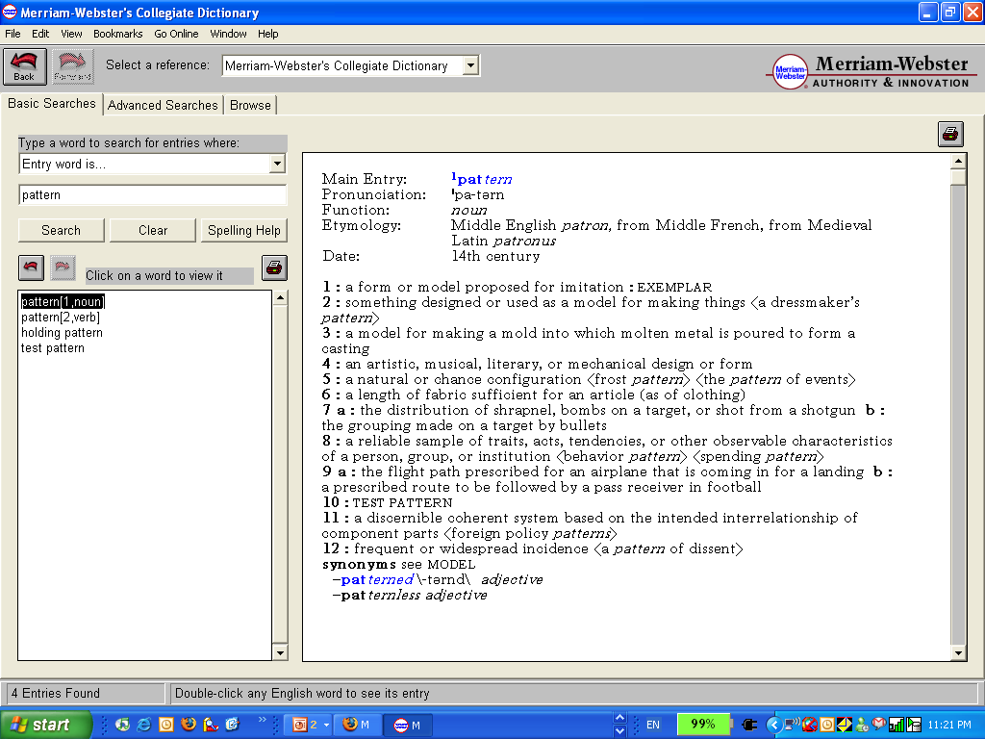
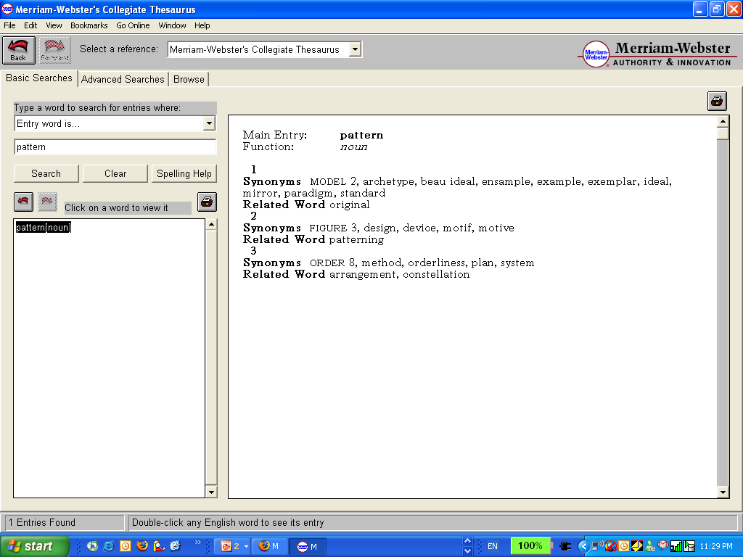
A Dictionary Analogy
Word: “pattern” – from Merriam-Webster
Non-semantic info.
Definitions indicating
semantics
Examples of Usage
Synonyms
Related Words
Notes:
‹#›

Slide 66
Semantic Analysis with Context Models
Task1: Model the context of a frequent pattern
Based on the Context Model…
Task2: Extract strongest context indicators
Task3: Extract representative transactions
Task4: Extract semantically similar patterns
Notes:
‹#›

Slide 67
Annotating DBLP Co-authorship & Title Pattern
Database:
Frequent Patterns
Authors
Title
X.Yan, P. Yu, J. Han
Substructure Similarity Search
in Graph Databases
P₁: { x_yan, j_han }
Frequent Itemset
…
…
…
…
P₂: “substructure search”
Semantic Annotations
Pattern | { x_yan, j_han}
Non | Sup = …
CI | {p_yu}, graph pattern, …
Trans. | gSpan: graph-base……
SSPs | { j_wang }, {j_han, p_yu}, …
Context Units
< { p_yu, j_han}, { d_xin }, … , “graph pattern”, … “substructure similarity”, … >
Pattern = {xifeng_yan, jiawei_han}
Annotation Results:
Context Indicator (CI) | graph; {philip_yu}; mine close; graph pattern; sequential pattern; …
Representative Transactions (Trans) | > gSpan: graph-base substructure pattern mining; > mining close relational graph connect constraint; …
Semantically Similar Patterns (SSP) | {jiawei_han, philip_yu}; {jian_pei, jiawei_han}; {jiong_yang, philip_yu, wei_wang}; …

Slide 68
Chapter 7 : Advanced Frequent Pattern Mining
Pattern Mining: A Road Map
Pattern Mining in Multi-Level, Multi-Dimensional Space
Constraint-Based Frequent Pattern Mining
Mining High-Dimensional Data and Colossal Patterns
Mining Compressed or Approximate Patterns
Pattern Exploration and Application
Summary
‹#›
Notes:
‹#›

Slide 69
Summary
Roadmap: Many aspects & extensions on pattern mining
Mining patterns in multi-level, multi dimensional space
Mining rare and negative patterns
Constraint-based pattern mining
Specialized methods for mining high-dimensional data and colossal patterns
Mining compressed or approximate patterns
Pattern exploration and understanding: Semantic annotation of frequent patterns
‹#›
Notes:
‹#›

Slide 70
Ref: Mining Multi-Level and Quantitative Rules
Y. Aumann and Y. Lindell. A Statistical Theory for Quantitative Association Rules, KDD'99
T. Fukuda, Y. Morimoto, S. Morishita, and T. Tokuyama. Data mining using two-dimensional optimized association rules: Scheme, algorithms, and visualization. SIGMOD'96.
J. Han and Y. Fu. Discovery of multiple-level association rules from large databases. VLDB'95.
R.J. Miller and Y. Yang. Association rules over interval data. SIGMOD'97.
R. Srikant and R. Agrawal. Mining generalized association rules. VLDB'95.
R. Srikant and R. Agrawal. Mining quantitative association rules in large relational tables. SIGMOD'96.
K. Wang, Y. He, and J. Han. Mining frequent itemsets using support constraints. VLDB'00
K. Yoda, T. Fukuda, Y. Morimoto, S. Morishita, and T. Tokuyama. Computing optimized rectilinear regions for association rules. KDD'97.
‹#›
Notes:
‹#›

Slide 71
Ref: Mining Other Kinds of Rules
F. Korn, A. Labrinidis, Y. Kotidis, and C. Faloutsos. Ratio rules: A new paradigm for fast, quantifiable data mining. VLDB'98
Y. Huhtala, J. Kärkkäinen, P. Porkka, H. Toivonen. Efficient Discovery of Functional and Approximate Dependencies Using Partitions. ICDE’98.
H. V. Jagadish, J. Madar, and R. Ng. Semantic Compression and Pattern Extraction with Fascicles. VLDB'99
B. Lent, A. Swami, and J. Widom. Clustering association rules. ICDE'97.
R. Meo, G. Psaila, and S. Ceri. A new SQL-like operator for mining association rules. VLDB'96.
A. Savasere, E. Omiecinski, and S. Navathe. Mining for strong negative associations in a large database of customer transactions. ICDE'98.
D. Tsur, J. D. Ullman, S. Abitboul, C. Clifton, R. Motwani, and S. Nestorov. Query flocks: A generalization of association-rule mining. SIGMOD'98.
‹#›
Notes:
‹#›

Slide 72
Ref: Constraint-Based Pattern Mining
R. Srikant, Q. Vu, and R. Agrawal. Mining association rules with item constraints. KDD'97
R. Ng, L.V.S. Lakshmanan, J. Han & A. Pang. Exploratory mining and pruning optimizations of constrained association rules. SIGMOD’98
G. Grahne, L. Lakshmanan, and X. Wang. Efficient mining of constrained correlated sets. ICDE'00
J. Pei, J. Han, and L. V. S. Lakshmanan. Mining Frequent Itemsets with Convertible Constraints. ICDE'01
J. Pei, J. Han, and W. Wang, Mining Sequential Patterns with Constraints in Large Databases, CIKM'02
F. Bonchi, F. Giannotti, A. Mazzanti, and D. Pedreschi. ExAnte: Anticipated Data Reduction in Constrained Pattern Mining, PKDD'03
F. Zhu, X. Yan, J. Han, and P. S. Yu, “gPrune: A Constraint Pushing Framework for Graph Pattern Mining”, PAKDD'07
‹#›
Notes:
‹#›

Slide 73
Ref: Mining Sequential Patterns
X. Ji, J. Bailey, and G. Dong. Mining minimal distinguishing subsequence patterns with gap constraints. ICDM'05
H. Mannila, H Toivonen, and A. I. Verkamo. Discovery of frequent episodes in event sequences. DAMI:97.
J. Pei, J. Han, H. Pinto, Q. Chen, U. Dayal, and M.-C. Hsu. PrefixSpan: Mining Sequential Patterns Efficiently by Prefix-Projected Pattern Growth. ICDE'01.
R. Srikant and R. Agrawal. Mining sequential patterns: Generalizations and performance improvements. EDBT’96.
X. Yan, J. Han, and R. Afshar. CloSpan: Mining Closed Sequential Patterns in Large Datasets. SDM'03.
M. Zaki. SPADE: An Efficient Algorithm for Mining Frequent Sequences. Machine Learning:01.
‹#›
Notes:
‹#›

Slide 74
Mining Graph and Structured Patterns
A. Inokuchi, T. Washio, and H. Motoda. An apriori-based algorithm for mining frequent substructures from graph data. PKDD'00
M. Kuramochi and G. Karypis. Frequent Subgraph Discovery. ICDM'01.
X. Yan and J. Han. gSpan: Graph-based substructure pattern mining. ICDM'02
X. Yan and J. Han. CloseGraph: Mining Closed Frequent Graph Patterns. KDD'03
X. Yan, P. S. Yu, and J. Han. Graph indexing based on discriminative frequent structure analysis. ACM TODS, 30:960–993, 2005
X. Yan, F. Zhu, P. S. Yu, and J. Han. Feature-based substructure similarity search. ACM Trans. Database Systems, 31:1418–1453, 2006
‹#›

Slide 75
Ref: Mining Spatial, Spatiotemporal, Multimedia Data
H. Cao, N. Mamoulis, and D. W. Cheung. Mining frequent spatiotemporal sequential patterns. ICDM'05
D. Gunopulos and I. Tsoukatos. Efficient Mining of Spatiotemporal Patterns. SSTD'01
K. Koperski and J. Han, Discovery of Spatial Association Rules in Geographic Information Databases, SSD’95
H. Xiong, S. Shekhar, Y. Huang, V. Kumar, X. Ma, and J. S. Yoo. A framework for discovering co-location patterns in data sets with extended spatial objects. SDM'04
J. Yuan, Y. Wu, and M. Yang. Discovery of collocation patterns: From visual words to visual phrases. CVPR'07
O. R. Zaiane, J. Han, and H. Zhu, Mining Recurrent Items in Multimedia with Progressive Resolution Refinement. ICDE'00
‹#›
Notes:
‹#›

Slide 76
Ref: Mining Frequent Patterns in Time-Series Data
B. Ozden, S. Ramaswamy, and A. Silberschatz. Cyclic association rules. ICDE'98.
J. Han, G. Dong and Y. Yin, Efficient Mining of Partial Periodic Patterns in Time Series Database, ICDE'99.
J. Shieh and E. Keogh. iSAX: Indexing and mining terabyte sized time series. KDD'08
B.-K. Yi, N. Sidiropoulos, T. Johnson, H. V. Jagadish, C. Faloutsos, and A. Biliris. Online Data Mining for Co-Evolving Time Sequences. ICDE'00.
W. Wang, J. Yang, R. Muntz. TAR: Temporal Association Rules on Evolving Numerical Attributes. ICDE’01.
J. Yang, W. Wang, P. S. Yu. Mining Asynchronous Periodic Patterns in Time Series Data. TKDE’03
L. Ye and E. Keogh. Time series shapelets: A new primitive for data mining. KDD'09
‹#›
Notes:
‹#›

Slide 77
Ref: FP for Classification and Clustering
G. Dong and J. Li. Efficient mining of emerging patterns: Discovering trends and differences. KDD'99.
B. Liu, W. Hsu, Y. Ma. Integrating Classification and Association Rule Mining. KDD’98.
W. Li, J. Han, and J. Pei. CMAR: Accurate and Efficient Classification Based on Multiple Class-Association Rules. ICDM'01.
H. Wang, W. Wang, J. Yang, and P.S. Yu. Clustering by pattern similarity in large data sets. SIGMOD’ 02.
J. Yang and W. Wang. CLUSEQ: efficient and effective sequence clustering. ICDE’03.
X. Yin and J. Han. CPAR: Classification based on Predictive Association Rules. SDM'03.
H. Cheng, X. Yan, J. Han, and C.-W. Hsu, Discriminative Frequent Pattern Analysis for Effective Classification”, ICDE'07
‹#›
Notes:
‹#›

Slide 78
Ref: Privacy-Preserving FP Mining
A. Evfimievski, R. Srikant, R. Agrawal, J. Gehrke. Privacy Preserving Mining of Association Rules. KDD’02.
A. Evfimievski, J. Gehrke, and R. Srikant. Limiting Privacy Breaches in Privacy Preserving Data Mining. PODS’03
J. Vaidya and C. Clifton. Privacy Preserving Association Rule Mining in Vertically Partitioned Data. KDD’02
‹#›
Notes:
‹#›

Slide 79
Mining Compressed Patterns
D. Xin, H. Cheng, X. Yan, and J. Han. Extracting redundancy-aware top-k patterns. KDD'06
D. Xin, J. Han, X. Yan, and H. Cheng. Mining compressed frequent-pattern sets. VLDB'05
X. Yan, H. Cheng, J. Han, and D. Xin. Summarizing itemset patterns: A profile-based approach. KDD'05
‹#›

Slide 80
Mining Colossal Patterns
F. Zhu, X. Yan, J. Han, P. S. Yu, and H. Cheng. Mining colossal frequent patterns by core pattern fusion. ICDE'07
F. Zhu, Q. Qu, D. Lo, X. Yan, J. Han. P. S. Yu, Mining Top-K Large Structural Patterns in a Massive Network. VLDB’11
‹#›

Slide 81
Ref: FP Mining from Data Streams
Y. Chen, G. Dong, J. Han, B. W. Wah, and J. Wang. Multi-Dimensional Regression Analysis of Time-Series Data Streams. VLDB'02.
R. M. Karp, C. H. Papadimitriou, and S. Shenker. A simple algorithm for finding frequent elements in streams and bags. TODS 2003.
G. Manku and R. Motwani. Approximate Frequency Counts over Data Streams. VLDB’02.
A. Metwally, D. Agrawal, and A. El Abbadi. Efficient computation of frequent and top-k elements in data streams. ICDT'05
‹#›
Notes:
‹#›

Slide 82
Ref: Freq. Pattern Mining Applications
T. Dasu, T. Johnson, S. Muthukrishnan, and V. Shkapenyuk. Mining Database Structure; or How to Build a Data Quality Browser. SIGMOD'02
M. Khan, H. Le, H. Ahmadi, T. Abdelzaher, and J. Han. DustMiner: Troubleshooting interactive complexity bugs in sensor networks., SenSys'08
Z. Li, S. Lu, S. Myagmar, and Y. Zhou. CP-Miner: A tool for finding copy-paste and related bugs in operating system code. In Proc. 2004 Symp. Operating Systems Design and Implementation (OSDI'04)
Z. Li and Y. Zhou. PR-Miner: Automatically extracting implicit programming rules and detecting violations in large software code. FSE'05
D. Lo, H. Cheng, J. Han, S. Khoo, and C. Sun. Classification of software behaviors for failure detection: A discriminative pattern mining approach. KDD'09
Q. Mei, D. Xin, H. Cheng, J. Han, and C. Zhai. Semantic annotation of frequent patterns. ACM TKDD, 2007.
K. Wang, S. Zhou, J. Han. Profit Mining: From Patterns to Actions. EDBT’02.
‹#›
Notes:
‹#›

